Slide 1


NARANDAS JETHALAL SONECHA MANAGEMENT & TECHNICAL INSTITUTE [AT: CHANDUVAV, VERAVAL ]
GAMESTORE
GUIDED BY:-
Prof. Dhruvi Sidhpura
Professor ,
Master of Computer Application (MCA)
PREPARED BY:-
Dwarkesh Gohel (215530694005)
Himanshu Dabhi (215530694004)
Parth Pandya (215530694002)

Slide 2
Flow of Presentation
INTRODUCTION
REQUIREMENT DETERMINATION AND ANALYSIS SYSTEM MANAGEMENT AND PLANNING
SYSTEM DESIGN
SYSTEM DESIGN AND DEVELOPMENT
DATA DICTIONARY
DEVELOPMENT
AGILE DOCUMENTATION
‹#›
8/8/2022
NARANDAS JETHALAL SONECHA MANAGEMENT &TECHNICAL INSTITUTE AT: CHANDUVAV, VERAVAL

Slide 3
Introduction
You can get several benefits with the learning objectives of e-commerce, like cost reduction, growth, gaining a popular brand image, and much more. Some of the most popular and primary objectives of E-Commerce are here:
Cost-effective Management
The primary aim of every business is to focus on cost reduction, and E-Commerce helps them do the same effectively. The automatic process of e-commerce helps to reduce the cost of management. The proper use of technology, Digital Marketing, can help you gain more customers without investing much.
Developing Business Relations
When businesses use e-commerce as a primary technique, they can easily grab achievement. When there is direct communication between the company and customers, the relationship boosts up. Eventually, companies can connect with more customers and result in increased growth.
‹#›
8/8/2022
NARANDAS JETHALAL SONECHA MANAGEMENT &TECHNICAL INSTITUTE AT: CHANDUVAV, VERAVAL

Slide 4
REQUIREMENT DETERMINATION AND ANALYSIS SYSTEM MANAGEMENT AND PLANNING
A Requirement is a vital feature of a new system which may include processing or capturing of data, controlling the activities of business, producing information and supporting the management.
Requirements determination involves studying the existing system and gathering details to find out what are the requirements, how it works, and where improvements should be made
‹#›
8/8/2022
NARANDAS JETHALAL SONECHA MANAGEMENT &TECHNICAL INSTITUTE AT: CHANDUVAV, VERAVAL

Slide 5
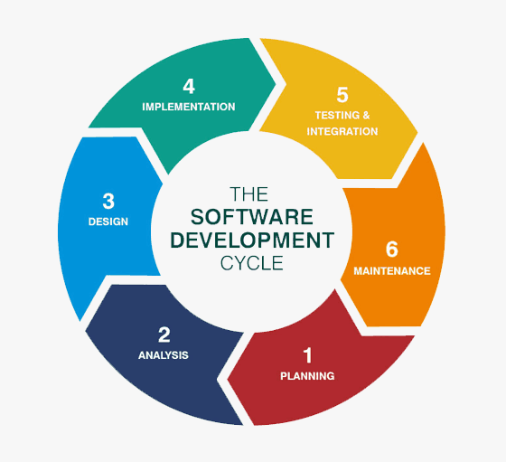
System Design and development
This includes graphical representation of the project planning and development and the scheduling of the project development.
Use Case Diagram
Activity Diagrams
Interaction Diagram
‹#›
8/8/2022
NARANDAS JETHALAL SONECHA MANAGEMENT &TECHNICAL INSTITUTE AT: CHANDUVAV, VERAVAL

Slide 6
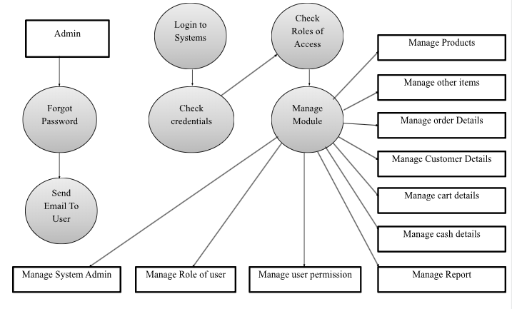
Interaction diagram
‹#›
8/8/2022
NARANDAS JETHALAL SONECHA MANAGEMENT &TECHNICAL INSTITUTE AT: CHANDUVAV, VERAVAL

Slide 7
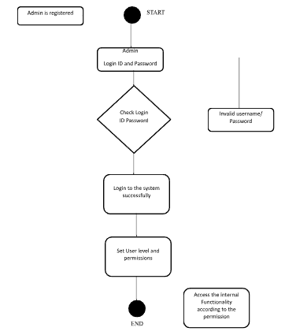
Activity Diagrams
Activity diagram is basically a flowchart to represent the flow from one activity to another activity. The activity can be described as an operation of the system. The control flow is drawn from one operation to another. It visually presents a series of actions or flow of control in a system
‹#›
8/8/2022
NARANDAS JETHALAL SONECHA MANAGEMENT &TECHNICAL INSTITUTE AT: CHANDUVAV, VERAVAL

Slide 8
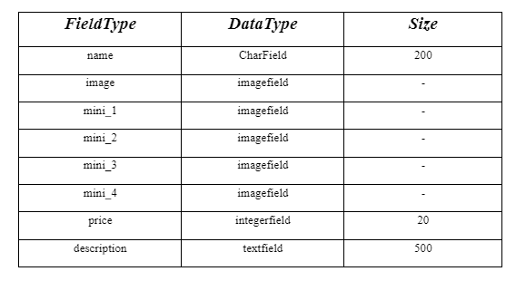
Data dictionary
Product table
‹#›
8/8/2022
NARANDAS JETHALAL SONECHA MANAGEMENT &TECHNICAL INSTITUTE AT: CHANDUVAV, VERAVAL

Slide 9
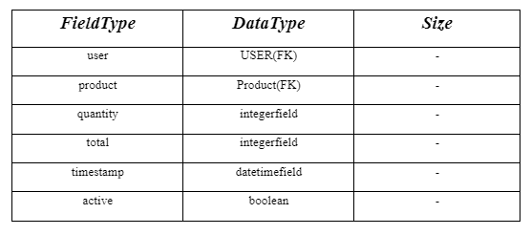
Data dictionary
Cart table
‹#›
8/8/2022
NARANDAS JETHALAL SONECHA MANAGEMENT &TECHNICAL INSTITUTE AT: CHANDUVAV, VERAVAL

Slide 10
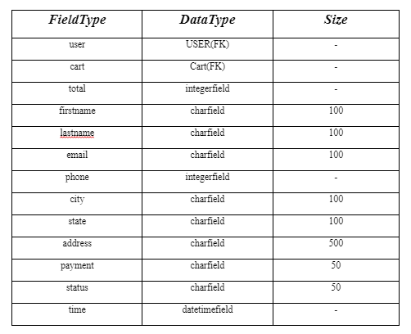
Data dictionary
orders table
‹#›
8/8/2022
NARANDAS JETHALAL SONECHA MANAGEMENT &TECHNICAL INSTITUTE AT: CHANDUVAV, VERAVAL

Slide 11
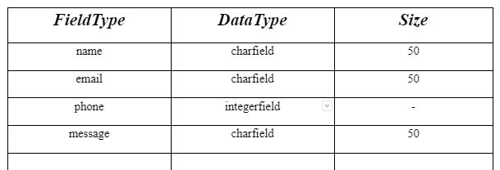
Data dictionary
Contact-us table
‹#›
8/8/2022
NARANDAS JETHALAL SONECHA MANAGEMENT &TECHNICAL INSTITUTE AT: CHANDUVAV, VERAVAL

Slide 12
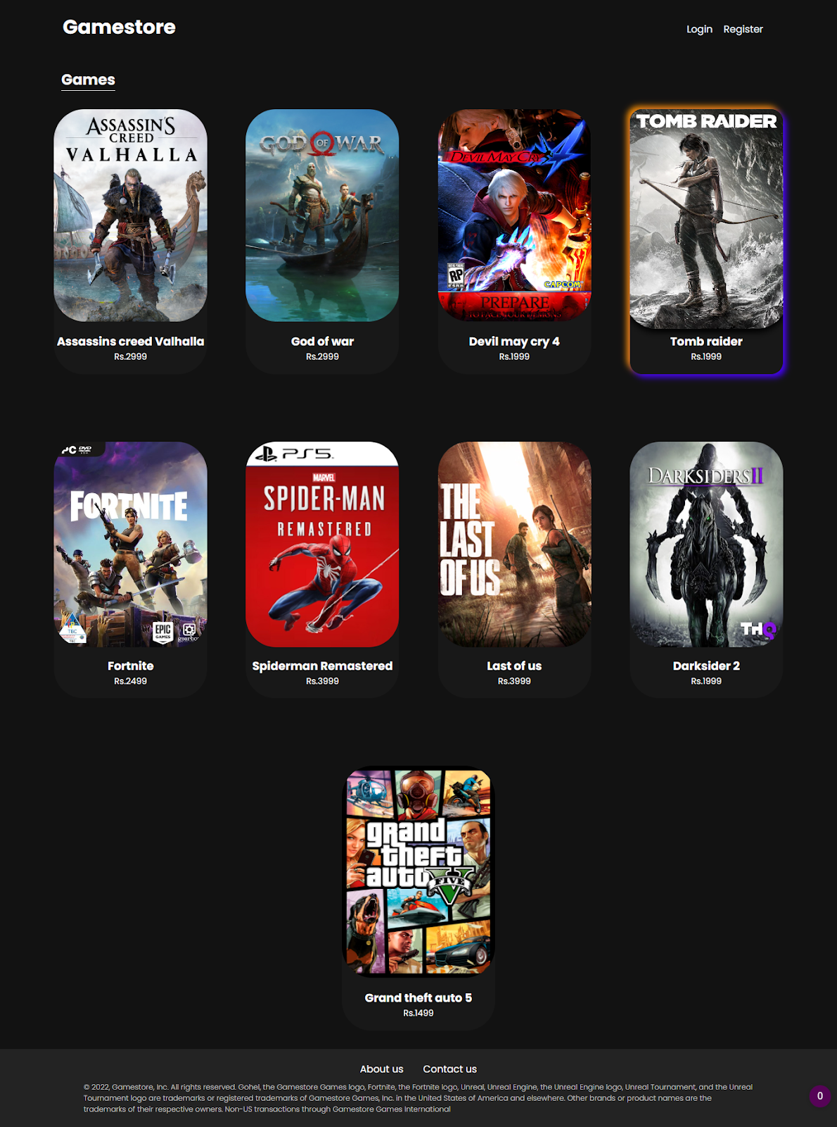
Homepage
‹#›
8/8/2022
NARANDAS JETHALAL SONECHA MANAGEMENT &TECHNICAL INSTITUTE AT: CHANDUVAV, VERAVAL

Slide 13
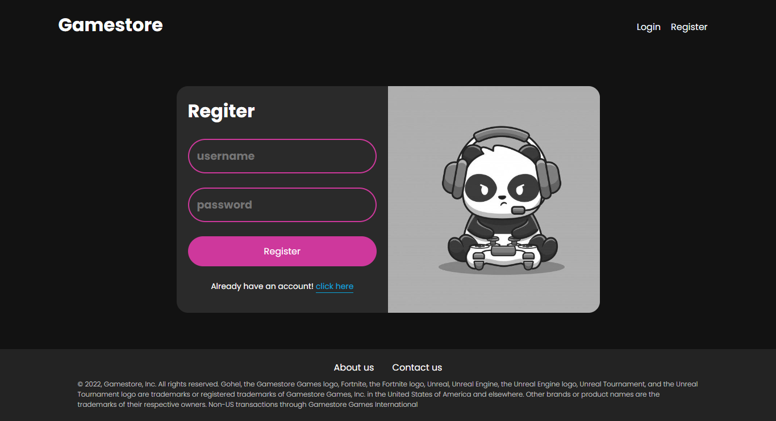
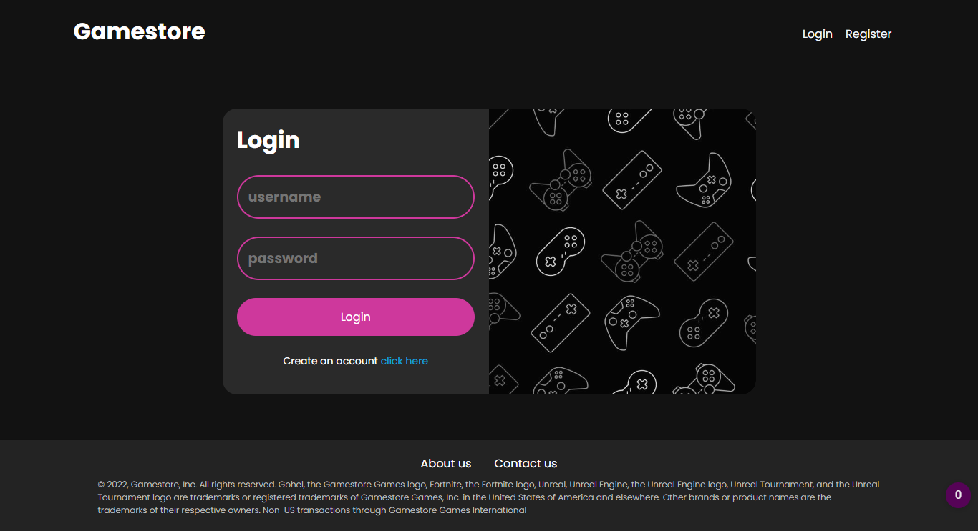
Register page
Login page
‹#›
8/8/2022
NARANDAS JETHALAL SONECHA MANAGEMENT &TECHNICAL INSTITUTE AT: CHANDUVAV, VERAVAL

Slide 14
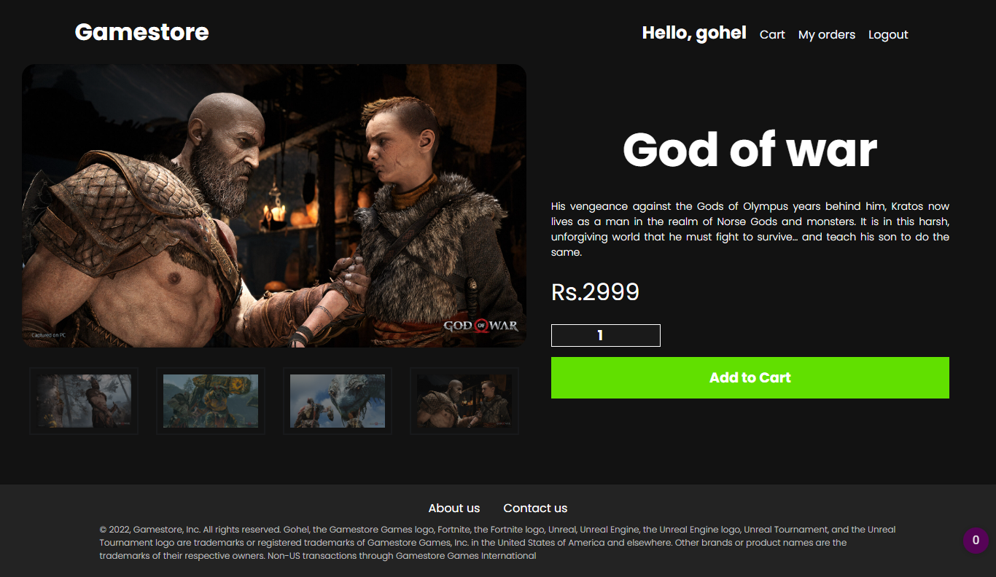
Gameview page
‹#›
8/8/2022
NARANDAS JETHALAL SONECHA MANAGEMENT &TECHNICAL INSTITUTE AT: CHANDUVAV, VERAVAL

Slide 15
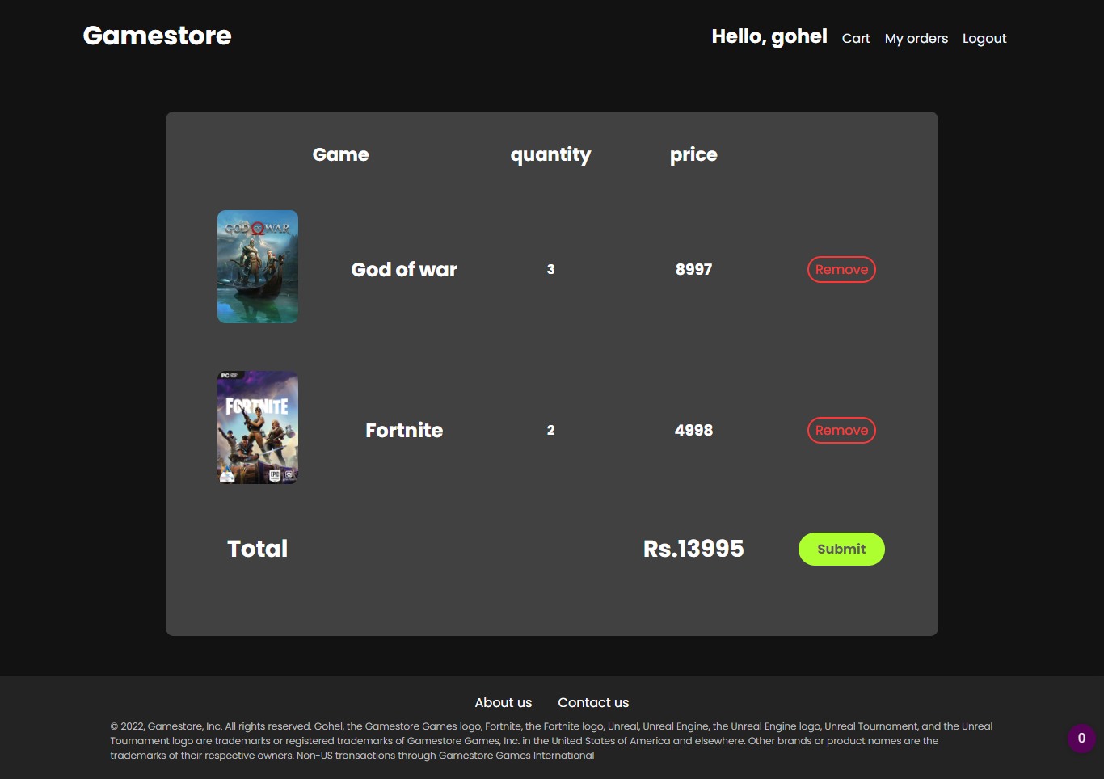
Cart page
‹#›
8/8/2022
NARANDAS JETHALAL SONECHA MANAGEMENT &TECHNICAL INSTITUTE AT: CHANDUVAV, VERAVAL

Slide 16
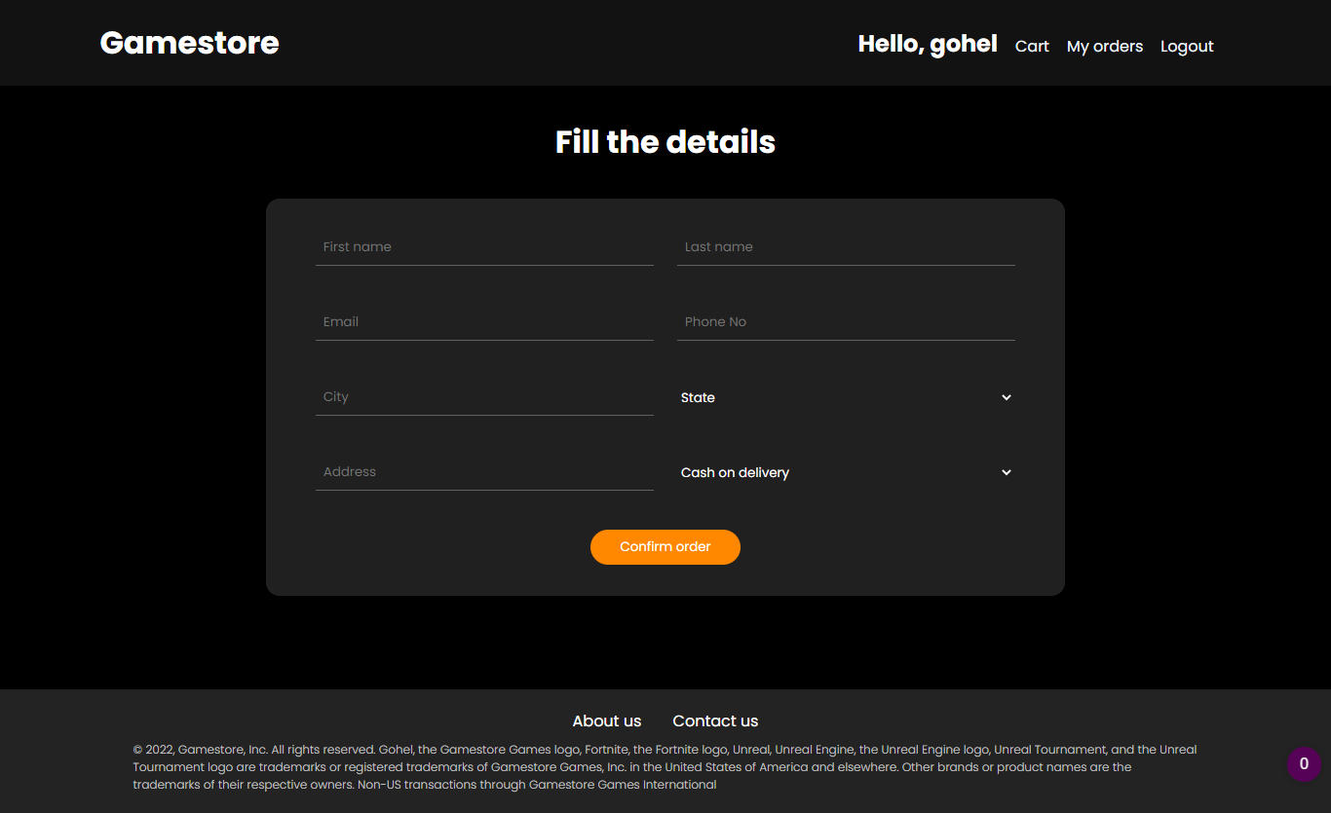
Checkout page
‹#›
8/8/2022
NARANDAS JETHALAL SONECHA MANAGEMENT &TECHNICAL INSTITUTE AT: CHANDUVAV, VERAVAL

Slide 17
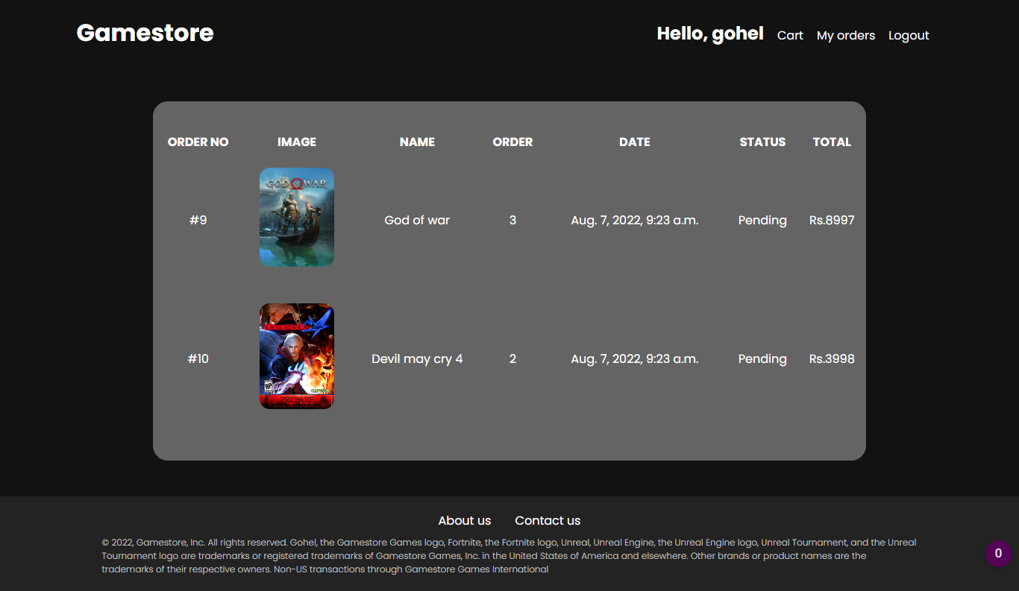
Myorders page
‹#›
8/8/2022
NARANDAS JETHALAL SONECHA MANAGEMENT &TECHNICAL INSTITUTE AT: CHANDUVAV, VERAVAL

Slide 18

About us page
‹#›
8/8/2022
NARANDAS JETHALAL SONECHA MANAGEMENT &TECHNICAL INSTITUTE AT: CHANDUVAV, VERAVAL

Slide 19
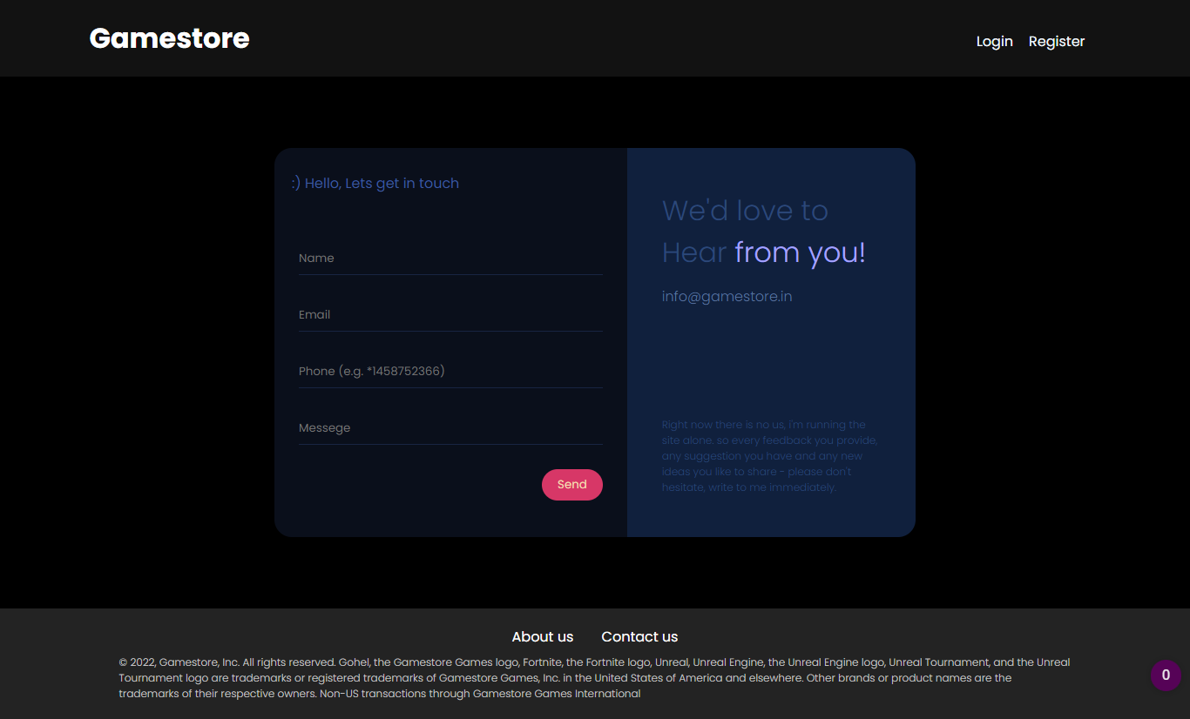
Contactus page
‹#›
8/8/2022
NARANDAS JETHALAL SONECHA MANAGEMENT &TECHNICAL INSTITUTE AT: CHANDUVAV, VERAVAL

Slide 20

‹#›
8/8/2022
NARANDAS JETHALAL SONECHA MANAGEMENT &TECHNICAL INSTITUTE AT: CHANDUVAV, VERAVAL

